Slide 1
Web Software Architecture CPEN 412: Multi-database connectivity
Richard S. Nsiah-Agyeman Jnr
10604655
Date:19th February, 2020

Slide 2
Overview
Introduction
Objectives
How TPMs work
Examples of TPM
Architectural Diagram of a Typical TPM
Implementing a TPM
Conclusion

Slide 3
Introduction
A Transactional Processing Monitor (TPM) is a type of distributed information system that offers a transactional programming model to allow an application to access multiple web servers.
TP Monitor makes sure that groups of updates take place together or not at all.

Slide 4
Objectives
Create a transaction processing monitor (TPM) for the NIA using a web application that accesses data from these four database servers.
Create a user-friendly interface to handle client requests

Slide 5
How TPMs work
Provide services such as:
Presentation facilities to simplify creating user interfaces
Persistent queuing of client requests and server responses
Routing of client messages to servers
Coordination of two-phase commit when transactions access multiple servers.

Slide 6
Examples of TPM
Microsoft Transaction server
CICS from IBM
Oracle TUXEDO

Slide 7
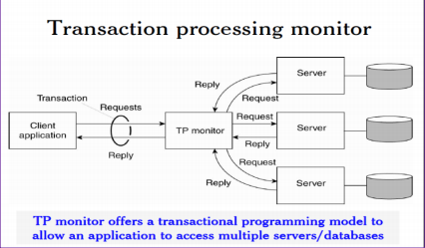
Architectural Diagram

Slide 8
Implementing a TPM
SqlAlchemy, a python library, was used to implement the transaction processing monitor. What it basically does is to bind all the database servers and translate python requests to SQL queries.
SqlAlchemy is only compatible with Flask framework (python lightweight framework)

Slide 9
Conclusion
Other forms of middleware, Transaction Processing Monitors have proven to be quite resilient with handling client requests on a distributed information system

